Slide 1

ALGORITHMIC THINKING
G.H.Joshi
Professor, Computer Science and Engineering Department
BVB College of Engineering and Technology
Vidyanagar, Hubli.
E_mail : ghjoshi@bvb.edu

Slide 2
Problem 1
A peasant finds himself on a riverbank with a wolf, a goat, and a head of cabbage. He needs to transport all three to the other side of the river in his boat. However, the boat has room for only the peasant himself and one other item (either the wolf, the goat, or the cabbage). In his absence, the wolf would eat the goat, and the goat would eat the cabbage. Solve this problem for the peasant or prove it has no solution.
(Note: The peasant is a vegetarian but does not like cabbage and hence can eat neither the goat nor the cabbage to help him solve the problem. And it goes without saying that the wolf is a protected species.)

Slide 3
Solution
Let P, w, g, and c stand for the peasant, wolf, goat, and cabbage head, respectively. The following is principal sequences that solve the problem:
Intial |  |  |  |  |  |  | Final
BANK B | P G | G | P W G | W | P W C | W C | PWGC
R I V E R
PWGC | W C | P W C | C | P G C | G | P G | BANK A
1
2
3
4
6
7
5

Slide 4
Solution
Initially P,W,G and C are on BANK A
Person P moves from BANK A to BANK B with Goat G .
Person P moves from BANK B to BANK A.
Person P moves from BANK A to BANK B with Wolf W.
Person P moves from BANK B to BANK A with Goat G .
Person P moves from BANK A to BANK B with Cabbage C .
Person P moves from BANK B to BANK A
Person P moves from BANK A to BANK B with Goat G .
        skip to

Slide 5
Problem 2
There are four people who want to cross a bridge; they all begin on the same side. You have 17 minutes to get them all across to the other side. It is night, and they have one flashlight. A maximum of two people can cross the bridge at one time. Any party that crosses, either one or two people, must have the flashlight with them. The flashlight must be walked back and forth; it cannot be thrown, for example. Person 1 takes 1 minute to cross the bridge, person 2 takes 2 minutes, person 3 takes 5 minutes, and person 4 takes 10 minutes. A pair must walk together at the rate of the slower person’s pace. For example, if person 1 and person 4 walk across first, 10 minutes have elapsed when they get to the other side of the bridge. If person 4 returns the flashlight, a total of 20 minutes have passed and you have failed the mission.
(Note: According to a rumor on the Internet, interviewers at a well-known software company located near Seattle have given this problem to interviewees.)

Slide 6
Solution
Let 1, 2, 5, 10 be labels representing the persons of the problem, f represent the flashlight’s location, and the number in the parenthesis be the total amount of time elapsed. The following sequence of moves solves the problem:
BANK B | f,1,2 | 2 | f,2,5,10 | 5,10 | f,1,2,5,10
R I I V E R
f,1,2,5,10 | 5,10 | f,1,5,10 | 1 | f,1,2 | BANK A
(0) (2) (3) (13) (15) (17)
Time in minutes

Slide 7
Solution
1. Initially all the persons 1,2,5,10 and flashlight are on BANK A.
2. Persons 1,2 move with flashlight from BANK A to BANK B.
3. Person 1 moves with flashlight from BANK B to BANK A.
4. Persons 5,10 moves with flashlight from BANK A to BANK B.
5. Person 2 moves with flashlight from BANK B to BANK A.
6. . Persons 1,2 moves with flashlight from BANK A to BANK B.
skip to

Slide 8
Algorithm
Definition 1: An algorithm is a precise, step-by-step set of instructions for solving a task.
Definition 2: An algorithm is a sequence of unambiguous instructions for solving a problem, i.e., for obtaining a required output for any legitimate input in a finite amount of time.
An algorithm does not solve a task; it gives you a series of steps
that, if executed correctly, will result in a solution to a task.

Slide 9
Characteristics of an algorithm
Finiteness
    terminates after a finite number of steps
Definiteness
    rigorously and unambiguously specified
Input
    valid inputs are clearly specified
Output
    can be proved to produce the correct output given a valid input
Effectiveness
    steps are sufficiently simple and basic Eg1. Eg2.

Slide 10
Algorithmic Thinking
It is the ability to understand, execute, evaluate and create algorithms.
To be an algorithmic thinker you need the ability to understand and execute algorithms. Some people find it easy to follow a series of precise instructions while other people find it very challenging. Some people seem to lack the patience and diligence required to follow a step-by-step plan. However, it is a valuable skill that all people should master. Algorithmic thinking requires patience because each instruction must be executed in its correct sequence without skipping ahead or "glossing over" some of the instructions. In addition, algorithmic thinking requires diligence and perseverance.

Slide 11
Algorithmic thinking also requires the ability to evaluate algorithms. This involves determining if an algorithm really does solve a given task. This can be very challenging. For example, a "preflight check list" is an algorithm for preparing an aircraft for take off.
And finally, Algorithmic thinking includes the ability to create new algorithms. This is probably the most challenging aspect of algorithmic thinking. Given a task, can you create a series of precise, step-by-step instructions that always solves the task correctly? Obviously the complexity of the task has a big impact on the complexity of an algorithm that will accomplish the task. Simple tasks can typically be accomplished with simple algorithms, while complex tasks typically require more complex algorithms.

Slide 12
Problem 3
7 6
5 1
4 3 8
What do you observe here ?

Slide 13
7 6 15
5 1 15
4 3 8 15
15 15 15 15 magic constant
Here, sums of each row, each column, and each main diagonal are same and this sum is called magic constant .
And this square, a magic square

Slide 14
Introduction to Magic Square
A magic square of order n is an arrangement of the numbers from 1 to n² in an n-by-n matrix, with each number occurring exactly once ,so that each row, each column, and each main diagonal has the same sum.

Slide 15

Magic Square for n = 3
6
1
8
7
5
3
2
9
4

Slide 16
Magic constant
If a magic square of order n exists, the magic constant in
question must be equal to n(n² + 1)/2.

Slide 17
Algorithm to generate Magic square
Start with the middle entry of the top row .
Place number 1 in that cell.
Move one cell up and one to the left cell to this, you have to assume that the top of the row “wraps round” to the bottom row and the left column “wraps round” to the right column.
If this cell is empty, write the next highest number in the sequence.
If the cell is not empty move down one cell within the same column.
Repeat step 3 to 5 until all cells have been completed.
End.

Slide 18
What are the limitations of this algorithm?

Slide 19
Problem 4
A tromino is an l-shaped tile formed by
1-by-1 adjacent squares. The problem is to cover any 2^{n}-by- 2^{n} chessboard with one missing square (anywhere on the board) with trominos. rominos should cover all the squares except the missing one with no overlaps.

Slide 20
Solution
solution

Slide 21
Problem 5
Towers of Hanoi:
We have n discs of different sizes and 3 pegs. Initially all the discs are on the first peg in order of size, the largest at the bottom, and the smallest on the top.
Goal: To move all the discs to the third peg using second one as an auxiliary if necessary.
Constraints: 1.Move only one disc at a time.
2.It is forbidden to place a larger disc on top of
smaller one.
Demonstration of Towers of Hanoi

Slide 22
Algorithmic Solution to Tower of Hanoi
Iterative solution for an even number of disks:
make the legal move between pegs A and B
make the legal move between pegs A and C
make the legal move between pegs B and C
repeat until complete
Iterative solution for an odd number of disks:
make the legal move between pegs A and C
make the legal move between pegs A and B
make the legal move between pegs B and C
repeat until complete
In each case, a total of 2^{n}-1 moves are made.

Slide 23
Recursive solution for ToH
To move n discs from peg A to peg C:
move n−1 discs from A to B. This leaves disc #n alone on peg A
move disc #n from A to C
move n−1 discs from B to C so they sit on disc #n

Slide 24
Another important algorithmic thinking
paradigm is
recursion

Slide 25
Problem 6
Welding Problem: To find the shortest tour for the
welding robot, through a given set of n welding spots

Slide 26
The problem gets transformed into a graph theory problem

Slide 27
Travelling Sales Persons Problem
Definition:
To find the shortest tour through a given set of n cities that visits each city exactly once before returning to the city where it started.
2
a
b
8
5
7
3
c
d
1

Slide 28
Solution to TSP
Tour | Length | Remarks
a->b->c->d->a | 2+8+1+7 = 18
a->b->d->c->a | 2+3+1+5 = 11 | Optimal
a->c->b->d->a | 5+8+3+7 = 23
a->c->d->b->a | 5+1+3+2 = 11 | Optimal
a->d->b->c->a | 7+3+8+5 = 23
a->d->c->b->a | 7+1+8+2 = 18

Slide 29
AIRWAYS
Hubli (HBX) to London(LON)
- Click here for online page. (Just enter the FROM & TO textbox as above)
- For images.
- First Possibility.
- Second Possibility.

Slide 30
RAILWAYS
Hubli (UBL) to Manglore(MAQ)
- Click here for online page. (Please enter the Source & Destination in the textbox)
- For images.
- First Possibility. Click here for maps.
- Second Possibility. Click here for maps.
-

Slide 31
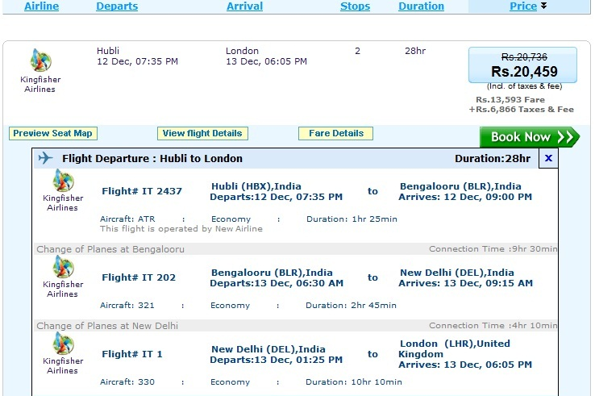
Back

Slide 32
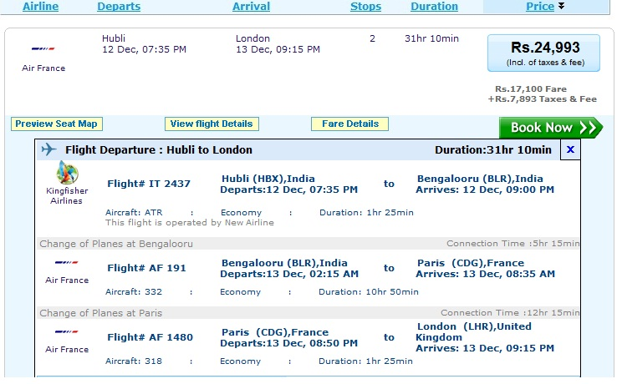
Back

Slide 33
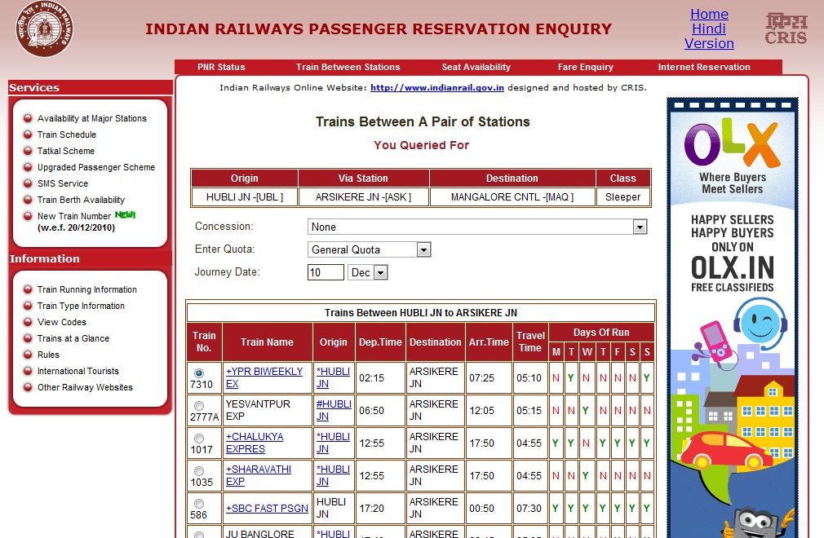
Back

Slide 34
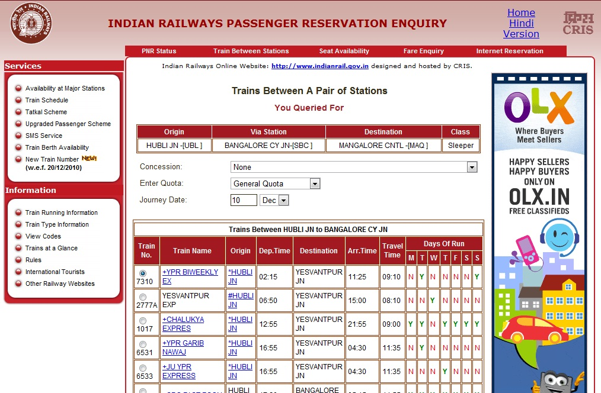
Back

Slide 35
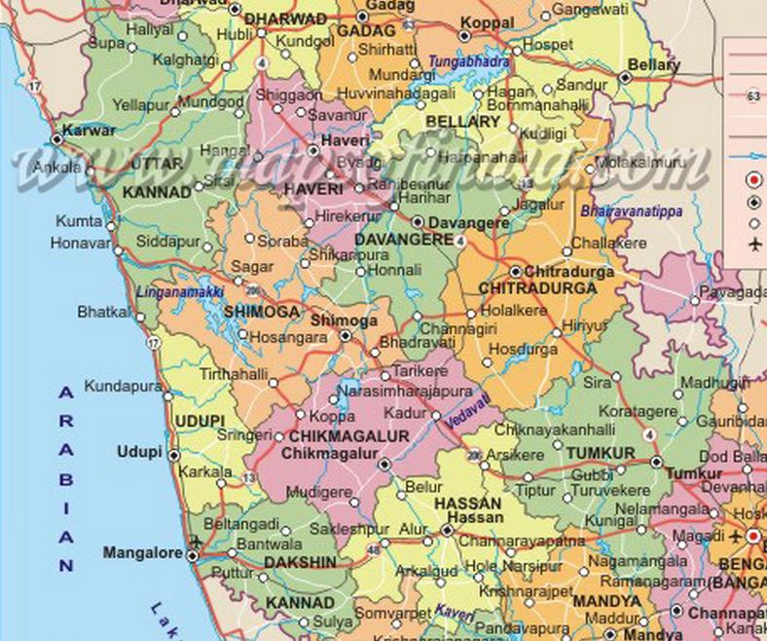
HUBLI
Back
ARSIKERE
MANGALORE

Slide 36
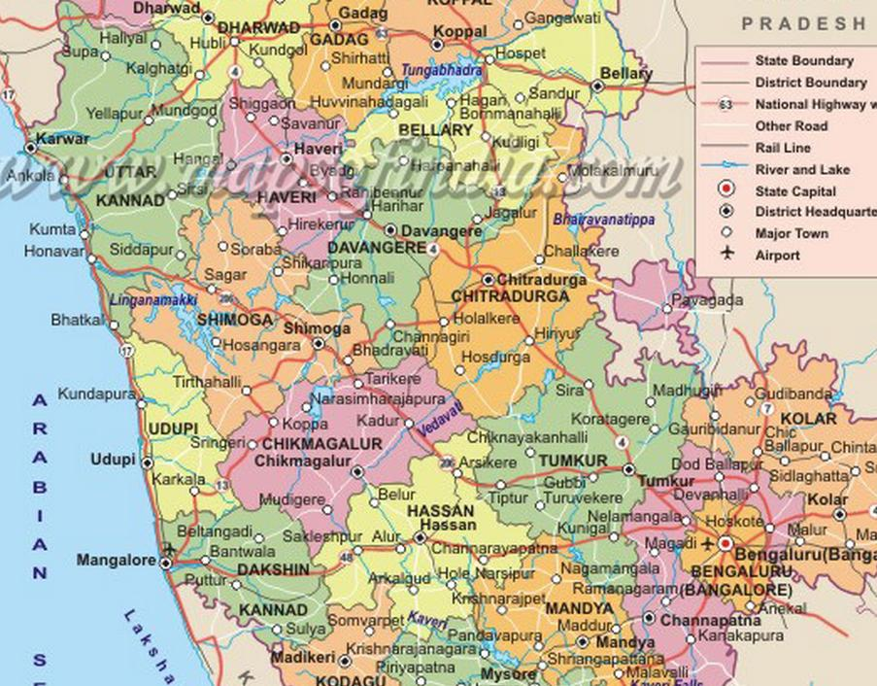
HUBLI
Back
BANGALURU
MANGALORE

Slide 37
Such problems are typical graph problems for which there exist
algorithmic solutions.

Slide 38
?

Slide 39
Thank you

